Slide 1

NFL visual data analysis application
Robert Oswald, Lukas Brander, Konstantin Benischke, Marc Velmeden

Slide 2
Motivation
NFL highly competitive
marginal difference between won and loss
Need for analysis:
difference between winning and losing often marginal
player performance, strategic tactics, game dynamics influenced by multiple factors
Purpose of the Tool:
insights into: player behavior, team tactics, offensive and defensive schemes
Core Functionalities:
visualization of player movements, interactive play analysis, detailed statistical insights, speed and acceleration analysis, interaction heatmap

Slide 3
Design process
User-Centered Design (UCD)
Rationale: Ensures the software meets the needs and preferences of the end users (coaches, analysts, players).
Steps:
  Analysis the other software
  Use expertise of our experts (Robert, Lukas)
  Task by Data Type Taxonomy
Interaction Design
Rationale: Enhances user engagement and usability through interactive elements.
Steps:
  Interactive Plots: Developed plots to visualize player movements, speed, acceleration, and proximity dynamically.
  User Interface (UI) Design: Created an intuitive layout with filters on the left side for easy access and interaction.
  overview first, zoom and filter, then details-on-demand
Inspiration:
Cooper, A., Reimann, R., & Cronin, D. (2007). About Face 3: The Essentials of Interaction Design. Wiley.
Shneiderman, B., & Plaisant, C. (2010). Designing the User Interface: Strategies for Effective Human-Computer Interaction (5th ed.). Upper Saddle River.
B. Baustädter and T. Schreck. Football and big data: A search engine for movements. July 2018
F. Silva.Visualizing shots, goals, players and more with SAS. Apr. 2020.
Notes:
Key Concepts and Principles:
Goal-Directed Design:
Central to the book is the concept of goal-directed design, which emphasizes designing products that help users achieve their goals efficiently and effectively.
The process involves understanding users' needs, behaviors, and motivations through thorough research and translating this understanding into design solutions.
Personas:
Personas are fictional characters representing different user types. They are created based on user research and are used to guide design decisions.
Personas help designers maintain a clear focus on user needs throughout the design process.
Scenarios and Use Cases:
Scenarios describe how personas interact with the product in specific contexts to achieve their goals.
Use cases are detailed descriptions of interactions between the user and the system, outlining steps to complete particular tasks.
Principles of Good Interaction Design:
Consistency: Ensuring a uniform experience across the interface to make it predictable and easy to learn.
Feedback: Providing clear, immediate feedback to users about the results of their actions.
Affordances: Designing elements that suggest their use, making interactions intuitive.
Simplicity: Reducing complexity by eliminating unnecessary elements and focusing on core functionalities.
Design Patterns:
The book introduces design patterns as reusable solutions to common design problems. Patterns help create consistent and effective user experiences.
Examples include navigation patterns, input patterns, and display patterns.
Visual Interface Design:
The book covers the principles of visual design, including layout, typography, color theory, and iconography.
It emphasizes the importance of aligning visual design with interaction design to create a cohesive user experience.
Prototyping and Testing:
Prototyping is presented as a crucial step in the design process, allowing designers to explore ideas and test assumptions early.
User testing is essential to validate designs with real users, ensuring the product meets their needs and expectations.
Collaboration and Communication:
The book discusses the importance of effective communication and collaboration within design teams and with stakeholders.
Techniques for presenting design concepts and obtaining feedback are also covered.

Slide 4
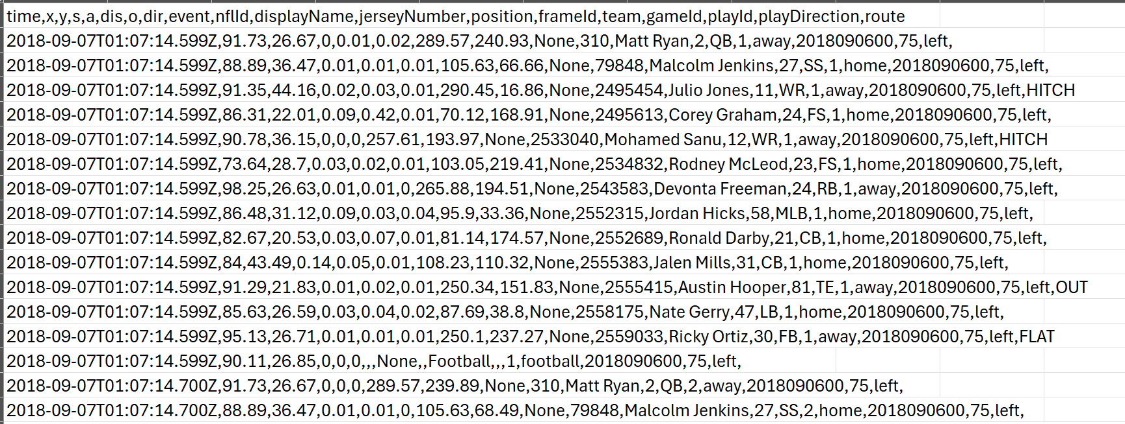
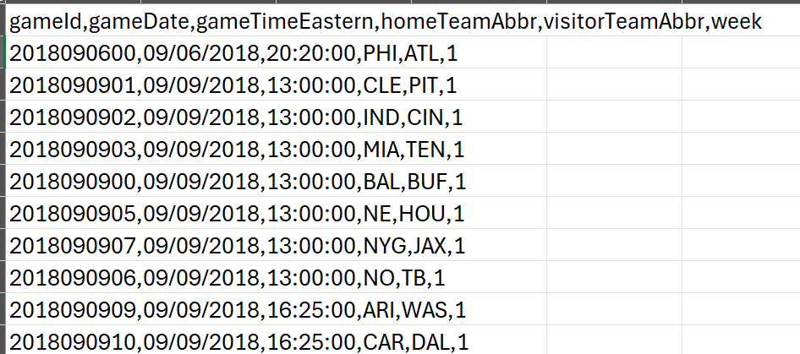
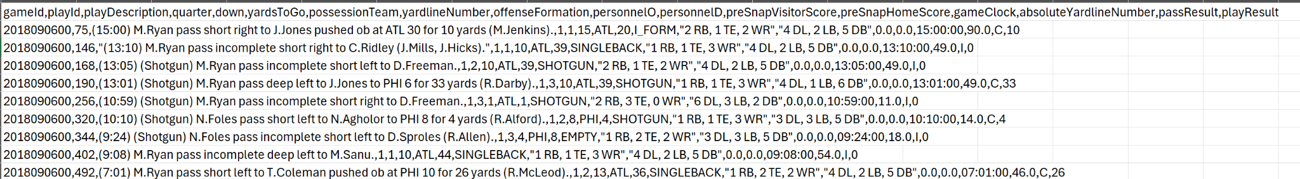
Description of your proposed solution along the "Design Triangle"
Data:
  games dataset:
    focuses on the when and where of games
    gameID, date, time, and home/away team
  week datasets:
    17 weekly datasets
    tracking data of players and ball (millisecond precision)
  plays dataset:
    describes each play of the game (gameID, playID)
    formations, score, play result

Slide 5
Description of your proposed solution along the "Design Triangle"
Users:
  Scouts, Coaches, Players, Fans, anyone interested in visual NFL game analytics
  American Football knowledge needed to understand output
Tasks:
  exploration and conformation of player performance
  3 different visualizations of game and play execution
Notes:
Who are the users of your solution? e.g., skill set and previous knowledge required?
Tasks: Which user tasks does your tool support? e.g., exploration, confirmation, comparison, grouping/generalization, trend analysis etc

Slide 6
Implementation
Language: Python 3.12
Libraries: Dash, dash_bootstrap_components, dash_ag_grid, plotly, pandas, numpy
Architecture:
The system was build with dash_ag_grid for a web application. The data was The view layer would be responsible for presenting the data to the user. dash_ag_grid serves as a part of this layer, providing a rich, interactive grid component that can display data in a tabular format. In Dash applications, the controller layer is somewhat merged with the view, as Dash uses callbacks to handle user interactions. These callbacks react to events in the view (e.g., a user clicking a button or changing a value in a dropdown) and update the view accordingly.
The data is handled in the api providing the necessary data preprocessing function.
The Plots were created in the plotly files. The plots were designed to be interactive in itself to improve performance and prohibiting to many callback requests.

Slide 7
Live demo or prepared video
show your implementation in action, show use cases (how would actual users apply your tool on their data, and what can they do and find with it?)

Slide 8
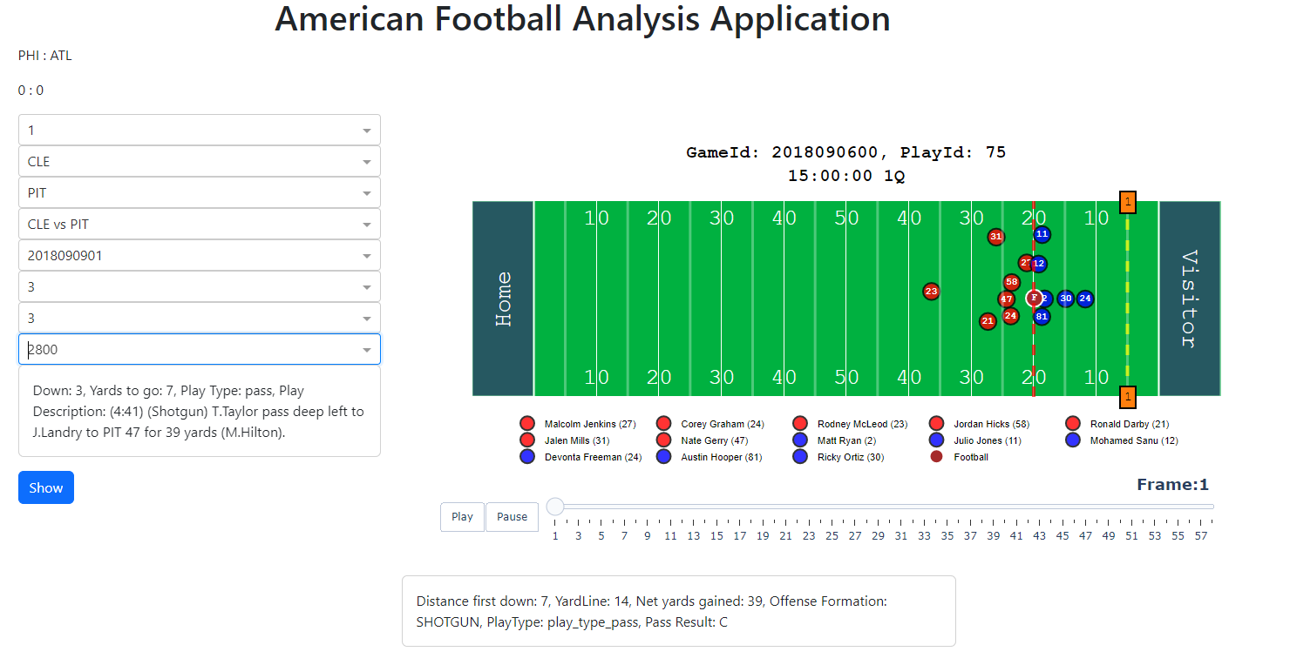
Discussion I
advantages/disadvantages of your approach
  Functional and Interactive Analysis Tool
  Practical for Real-Life Applications
  High Code Complexity
what went well?
  Effective Team Collaboration
  Extensive documentation

Slide 9
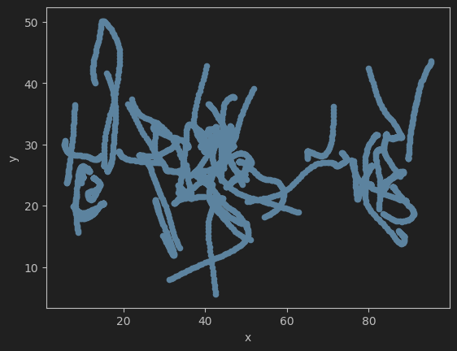
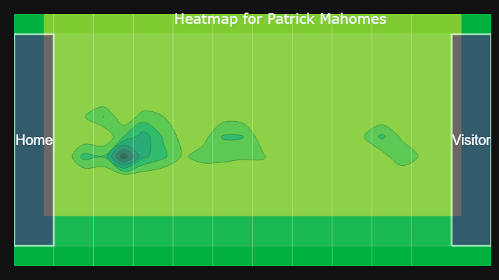
Discussion II
what were the difficulties?
  Managing Large, Non-Continuous Datasets
  Ensuring Complex Interactivity
what would you add if you had more time?
  Incorporate Player Heatmap
  Implement Lazy Loading
  Enhanced Graphics

Slide 10
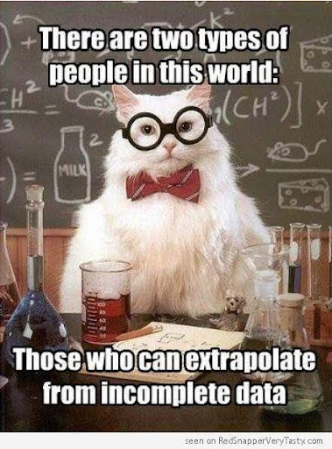
Thank you for your attention

